Slide 1


Unit 5
Data collection process: At the end of the day
Notes:
Welcome to Unit 5 of Module 4.

Slide 2
By the end of this unit, you will be able to:
describe the CSPro data collection tasks at the end of the day
explain who is responsible for each task in the process
Notes:
By the end of this unit, you will be able to:
describe the CSPro data collection tasks at the end of the day;
explain who is responsible for each task in the process.

Slide 3
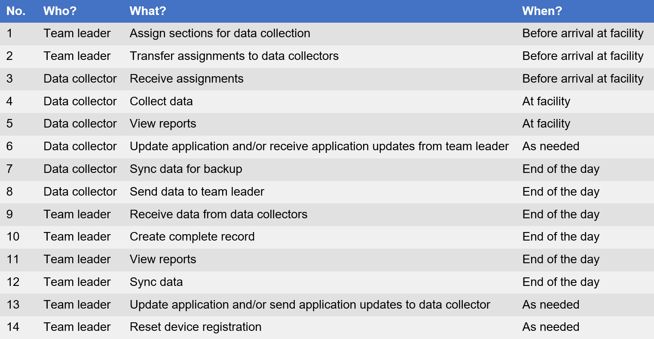
Process of data collection
Notes:
In this unit, we will explain the tasks that data collectors and team leaders need to carry out at the end of the data collection day.

Slide 4
7. Sync data for backup
Notes:
Let us start with the data collector backing up the HHFA data collected during the day.

Slide 5

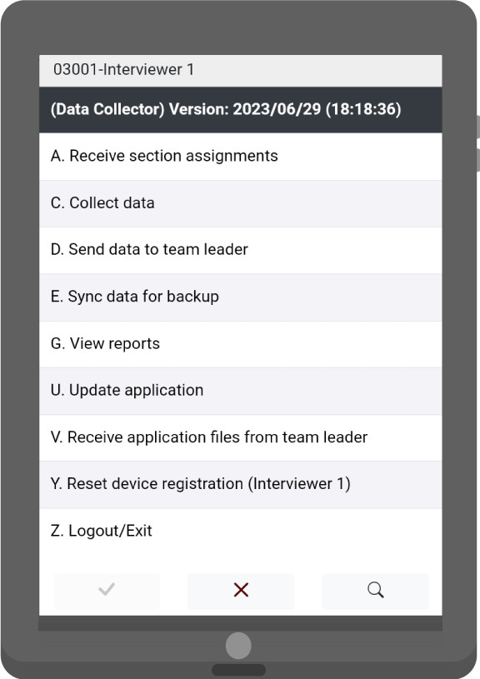
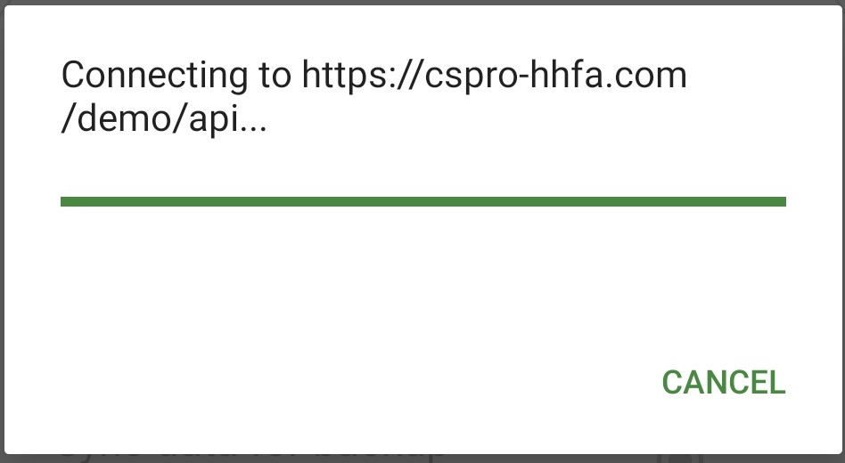
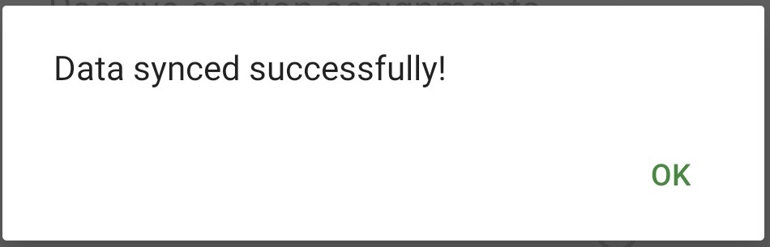
7. Sync data for backup
The sync option allows data collectors to send data directly to the server as a backup.
Select “Sync data for backup”
The application will connect to the internet and the server
Upon successful data sync, the following message appears
Notes:
The sync option allows data collectors to send data directly to the server as a backup.
The process is similar to sending the data to the team leader via the Internet and requires an active internet connection.
To sync data for backup:
data collectors select “Sync data for backup”;
the application will connect to the Internet and the server;
upon successful data sync, a message saying “Data synced successfully” appears.

Slide 6
DATA COLLECTOR: 8. Send data to team leader
TEAM LEADER: 9. Receive data from data collectors
Notes:
At the end of the working day, the data collector will send the data collected during the day to the team leader and the team leader will make sure to receive this data from the data collector.

Slide 7

DATA COLLECTOR: 8. Send data to team leader via Bluetooth
TEAM LEADER: 9. Receive data from data collector via Bluetooth
Bluetooth connection
data collector and team leader must be in proximity
their actions take place simultaneously
Notes:
Sending data to the team leader and receiving data from the data collectors can be done using a Bluetooth connection. This is similar to Task 2, where the team leader transfers the assigned sections of the questionnaire to the data collectors.
Both team leader and data collector must be in proximity and their actions take place simultaneously.

Slide 8
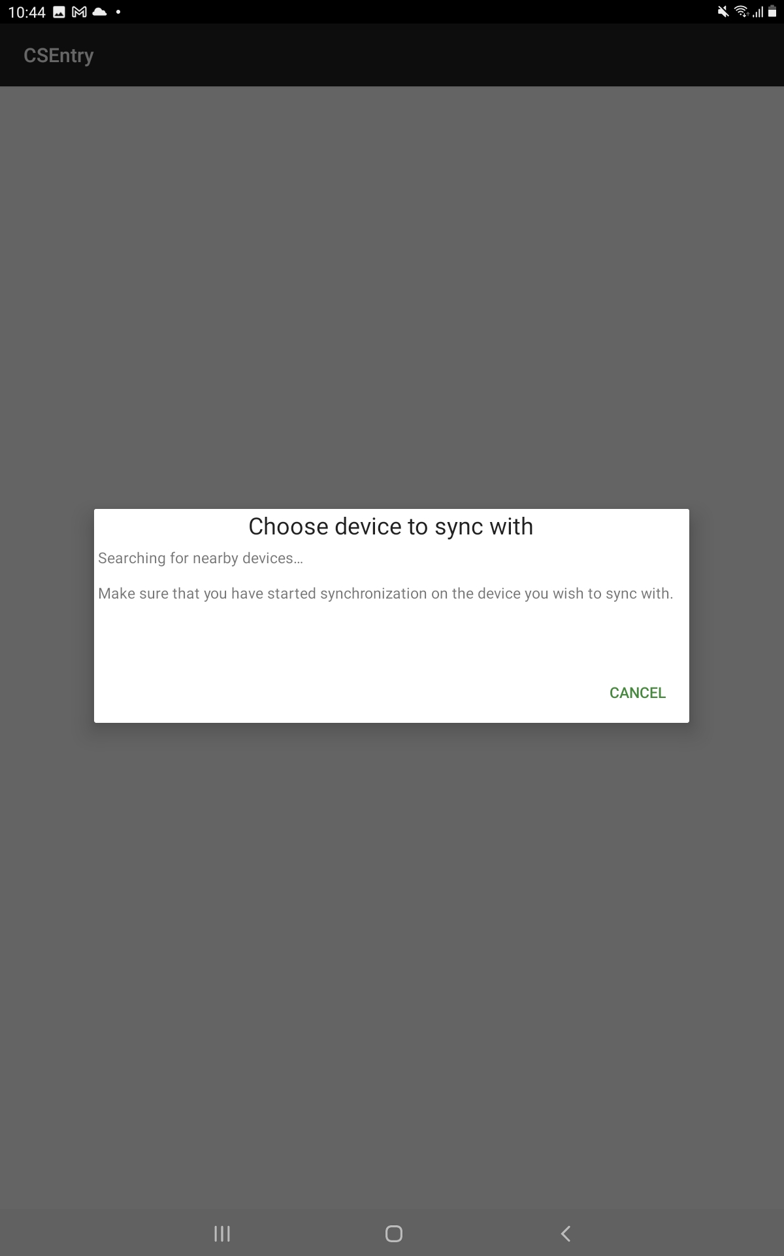

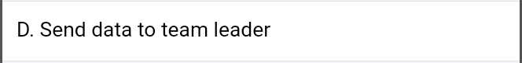
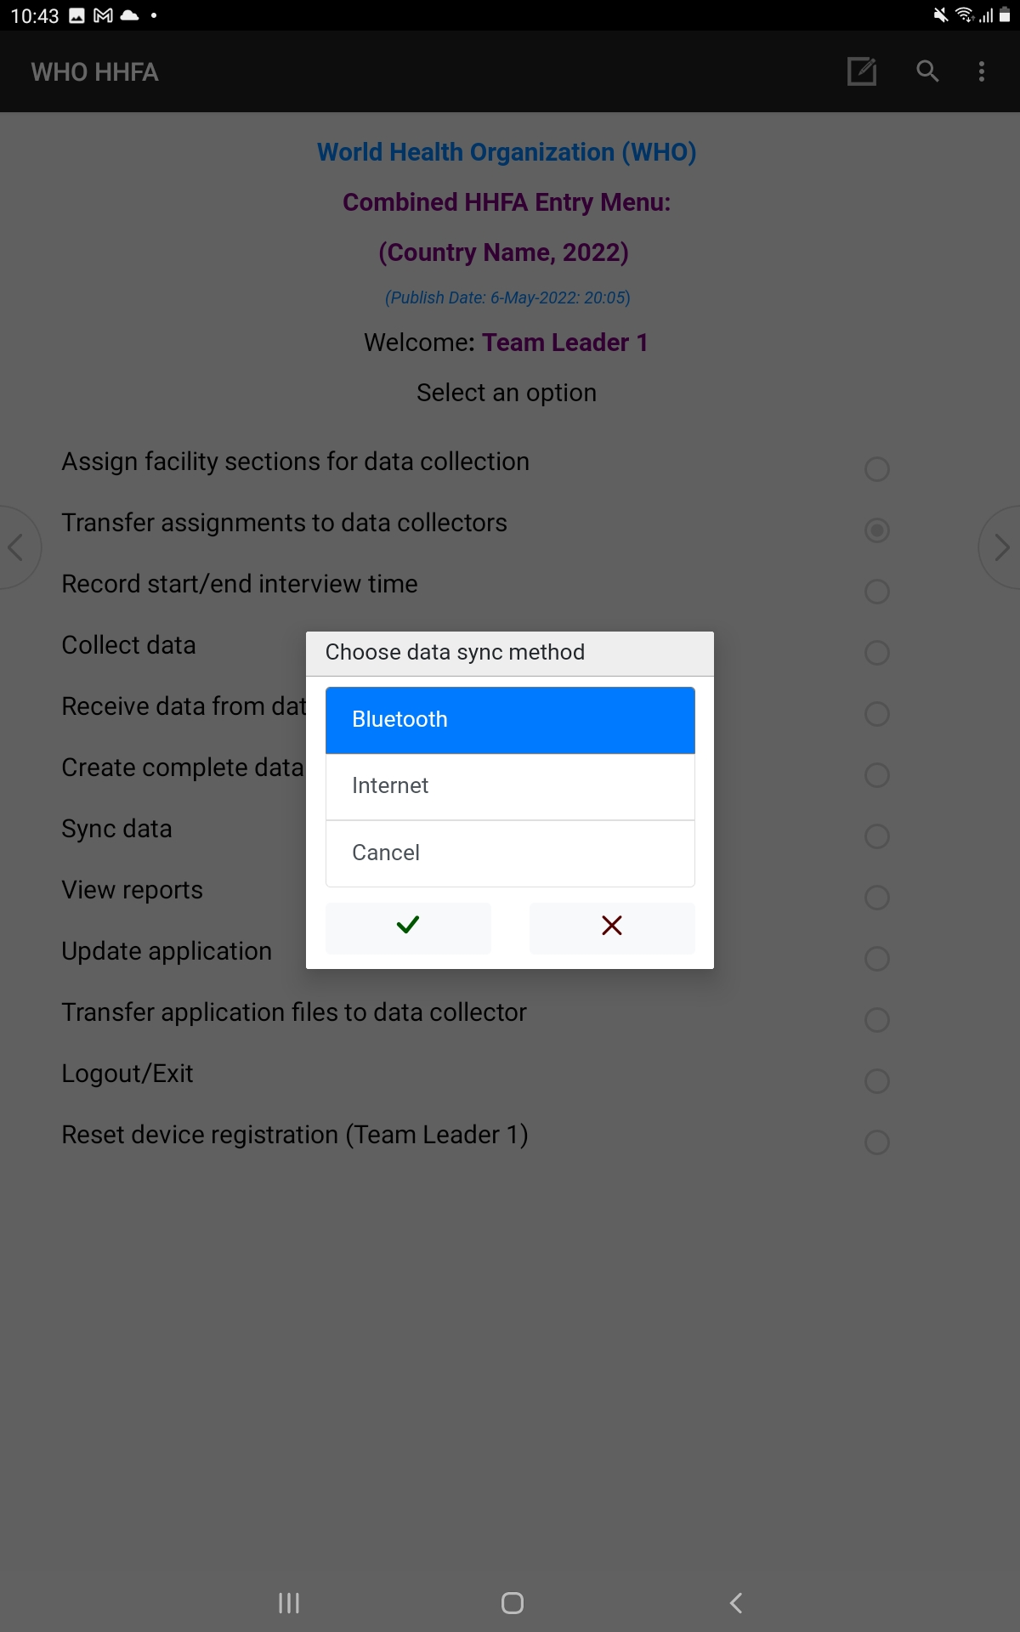

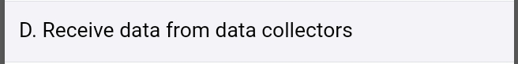
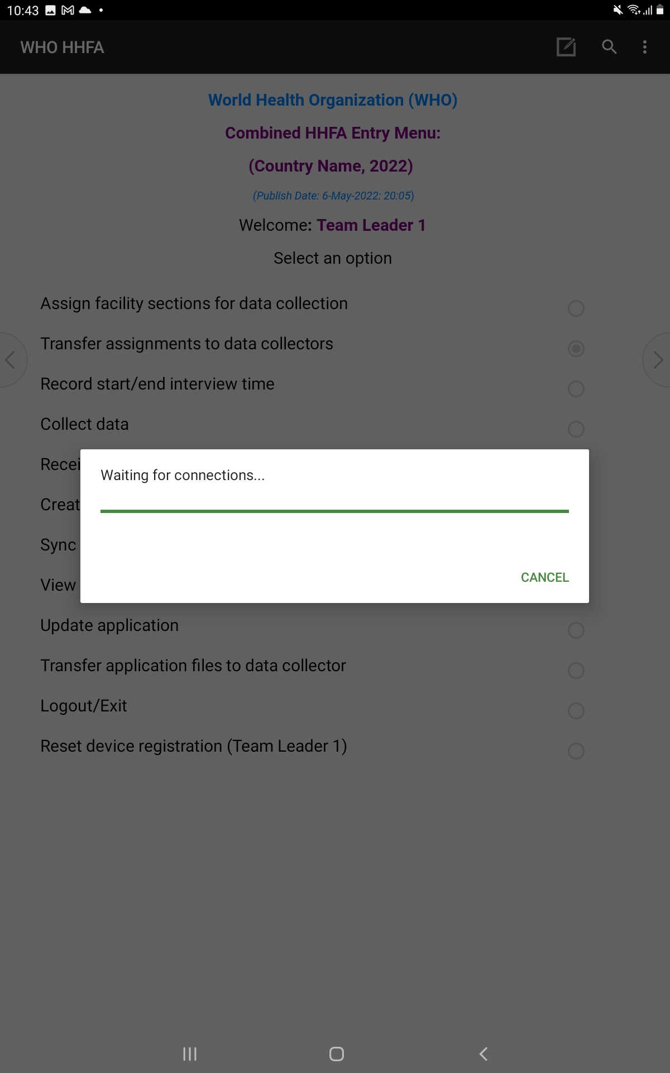
DATA COLLECTOR: 8. Send data to team leader via Bluetooth
TEAM LEADER: 9. Receive data from data collector via Bluetooth
Data collector sends pairing request to team leader
Data collector
Team leader
Team leader waits for pairing request/accepts
team leader can generate a report to check if data has been received
Notes:
The steps to send and receive data via Bluetooth are as follows:
the data collector selects “Send data to team leader”;
at the same time, the team leader selects “Receive data from data collectors”;
both team leader and data collector select Bluetooth as the sync method;
the data collector chooses the team leader’s device from the list and sends a pairing request;
the team leader waits for the pairing request from the data collector’s device and accepts it when it arrives to enable the devices to pair;
once the devices are paired and connected, the HHFA data will be transferred to the team leader’s device; and
the team leader can then generate a report to check if the data has been received.

Slide 9
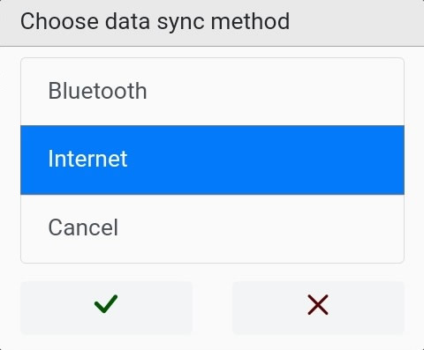
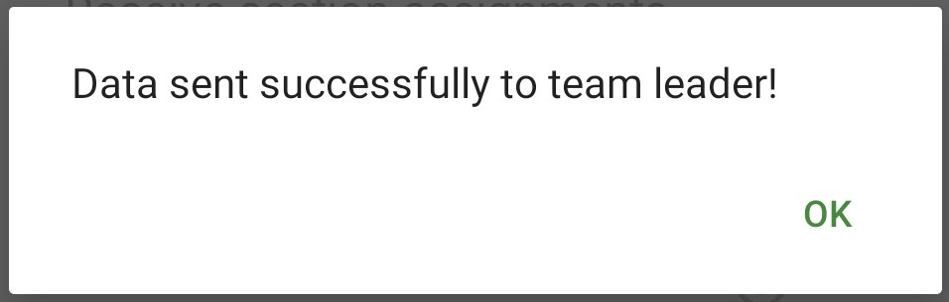
8. Send data to team leader via the internet
Data collector
Notes:
The steps for data transfer using the internet are as follows:
the data collector selects “Send data to team leader”;
next, the data collector selects “Internet” as the sync method;
the application will connect to the internet and the subsequent server;
on successful sync from the cloud, the message “Data sent successfully to team leader” will appear on the data collector’s device.

Slide 10
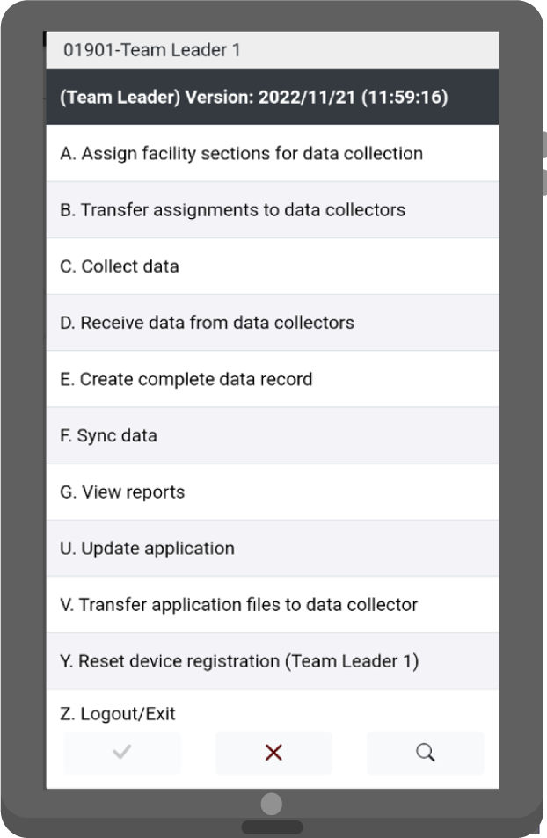
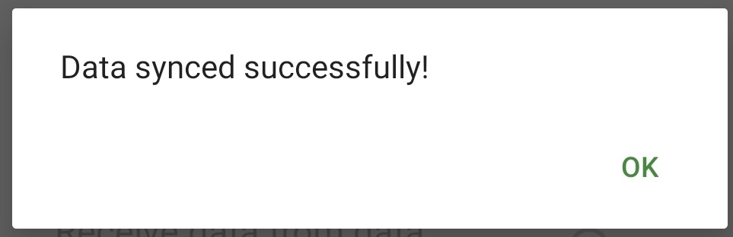
9. Receive data from data collectors via the internet
Team leader
Notes:
To receive data using the internet:
the team leader selects “Receive data from data collectors”;
then selects “Internet” as the sync method;
the application will connect to the internet and the subsequent server;
on successful sync to the cloud, the message “Data synced successfully” will appear on the team leader’s device.

Slide 11
10. Create complete record
Notes:
Once the team leader receives all the data from a health facility, they can create a complete record.

Slide 12
10. Create complete record
Team leader
Assignments
Data files
Facility Identifiers
Interviewer 1 assigned sections
Health Workforce
Interviewer 1
data file
Systems to support staff
Combined
facility data file
Facility beds and isolation units
Interviewer 2 assigned sections
Governance and management
Interviewer 2
data file
Systems for monitoring service quality
Notes:
Let us see how this is done:
based on the section assignments, each data collector will have data for a particular set of assigned sections for a single facility;
the data files from all the data collectors who have collected data at this facility must be combined to create a complete record for the facility;
this process is automated and everything runs in the background. The program checks through all the assignments done by the team leader, retrieves the associated data files, and merges them into a complete facility data file.

Slide 13
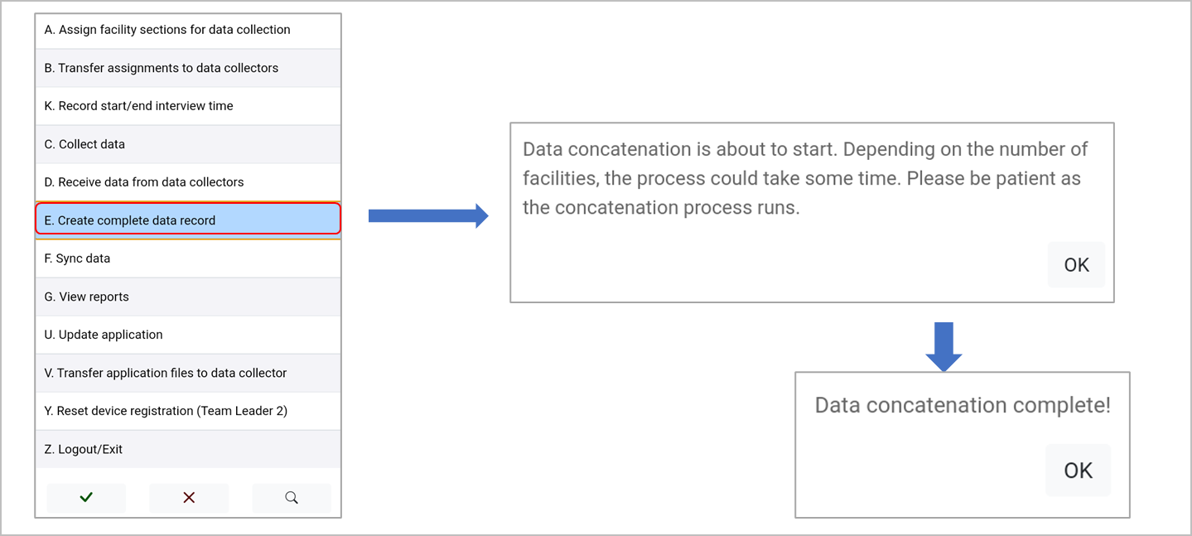
10. Create complete record
Team leader
Notes:
To create a complete record:
the team leader selects “Create complete data record” from the main menu;
a message appears, informing that data concatenation is about to start;
if the concatenation process is successful, the message “Data concatenation complete” appears.

Slide 14
11. View reports
Notes:
The team leader can then generate reports to track progress in data collection.

Slide 15
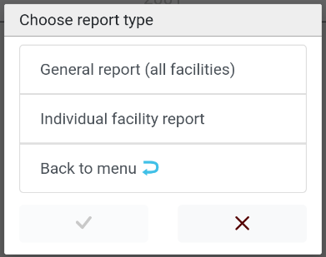
11. View reports
Generating reports
Select “View reports”
Select “report type”
Notes:
To generate a report:
team leaders select the “View reports” option from the main menu; and
then select the report type.
The team leader can generate 2 types of reports:
General report; and
Individual facility report.

Slide 16
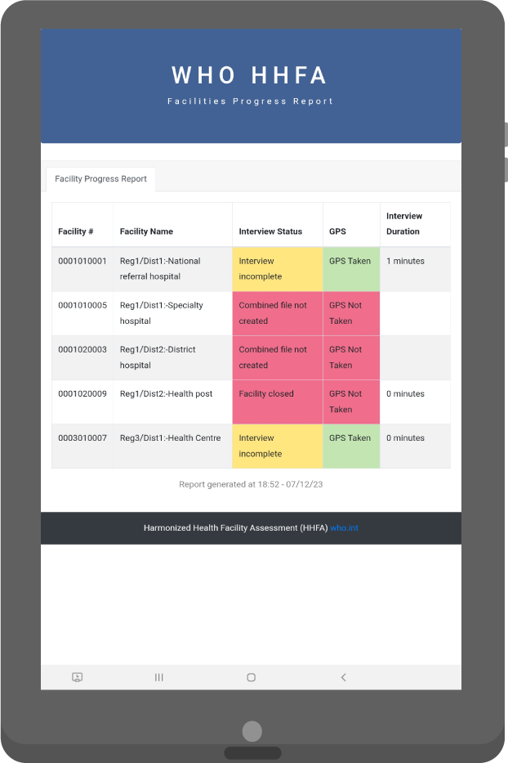
11. View reports
Team leader
1. General report (all facilities)
Outlines the interview status of the assigned health facilities and shows if the GPS coordinates have been collected.
Notes:
If “General report” is selected, the report will be displayed.​
​This report outlines the interview status of the assigned health facilities.
It also shows if the GPS coordinates for the facility have been collected.

Slide 17
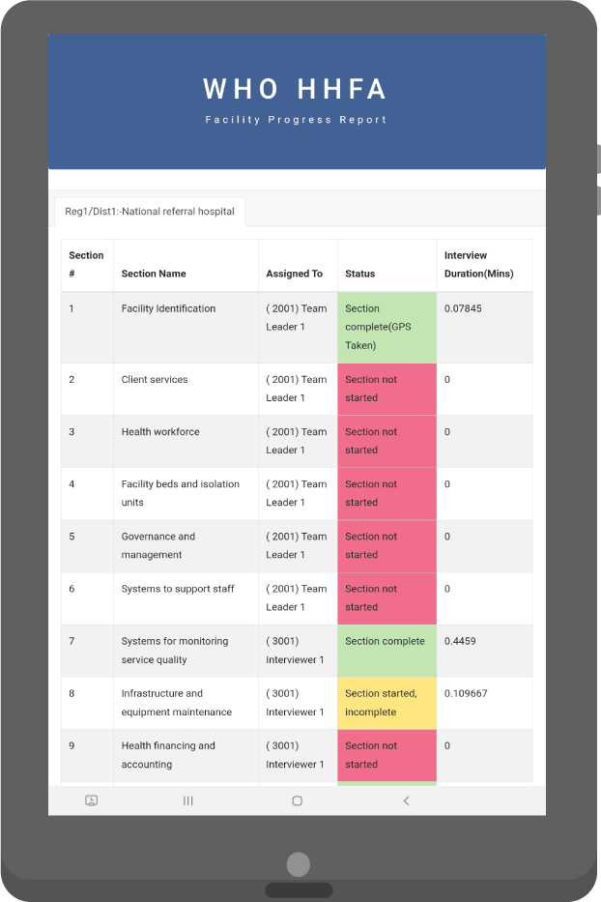
11. View reports
Team leader
2. Individual facility report
Shows the status and interview duration of each of the assigned sections for a single facility.
Notes:
If “Individual facility report” is selected, the facility must then be selected before the report is displayed.​
​This report shows the status and interview duration of each of the assigned sections for a single facility.

Slide 18
12. Sync data
Notes:
Once the team leader has finalized the daily data collection responsibilities, they need to sync the data to the server.

Slide 19
12. Sync data
The sync option allows team leaders to send data directly to the server.
3 data files are sent to the server:
assignments file
original data collector data file
complete facility record
Notes:
The sync option allows team leaders to send data directly to the server.
During this process, 3 data files are sent to the server:
the assignments file;
the original data collector data file; and
the complete facility record.
The process requires an active internet connection.

Slide 20
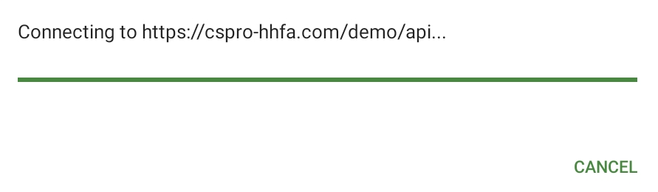
12. Sync data
Team leader
Select “Sync data”
Application will connect to the server
Notes:
To sync data:
1. the team leader selects “Sync data” from the main menu;
2. the application will connect to the internet and the server;

Slide 21
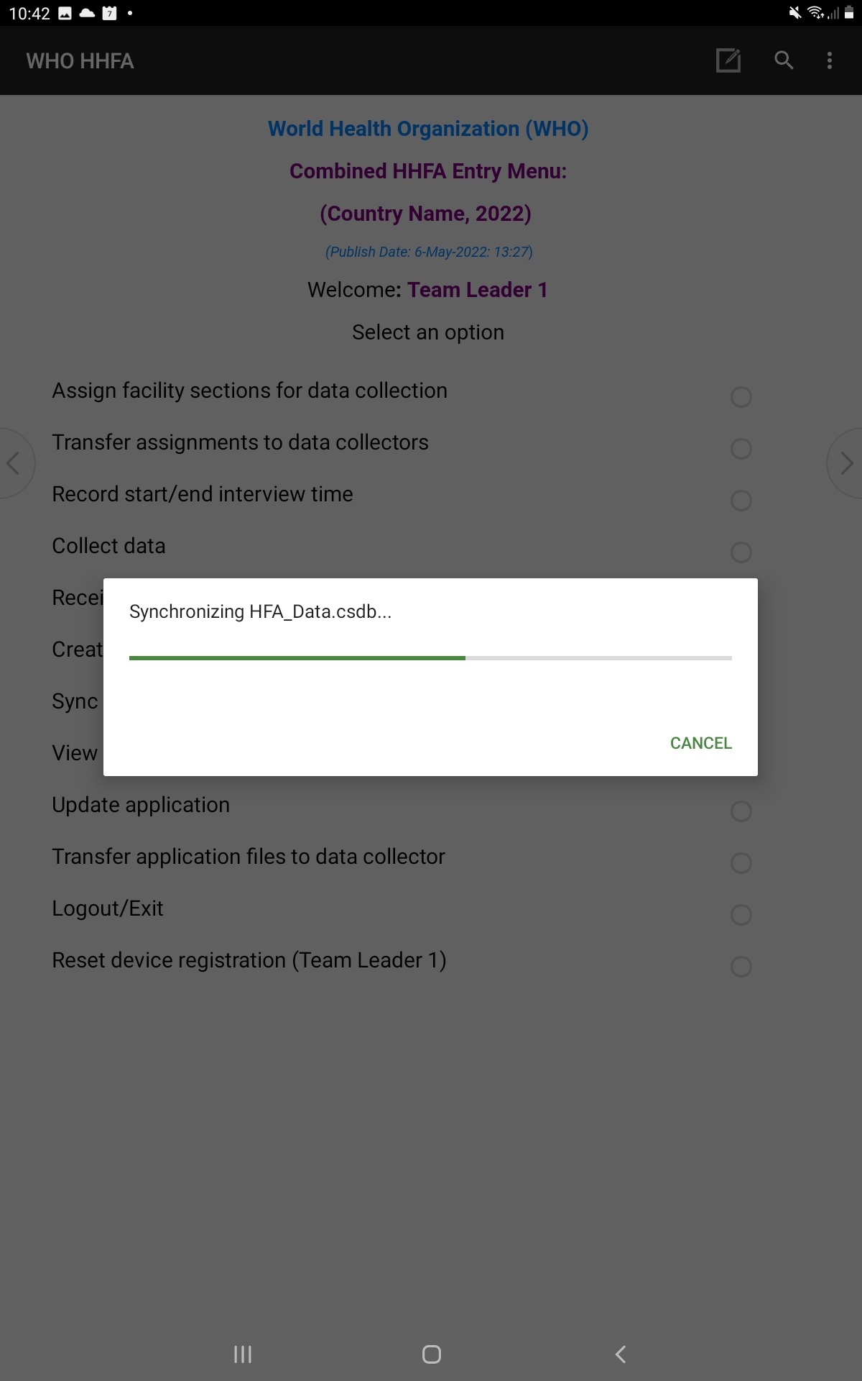
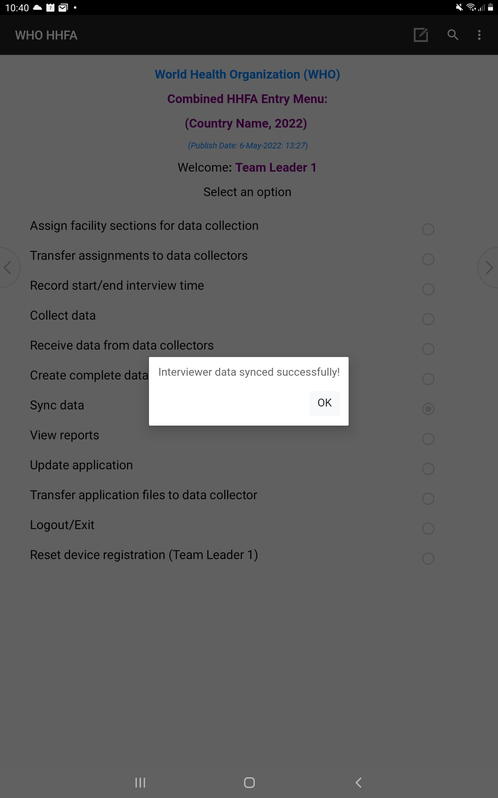
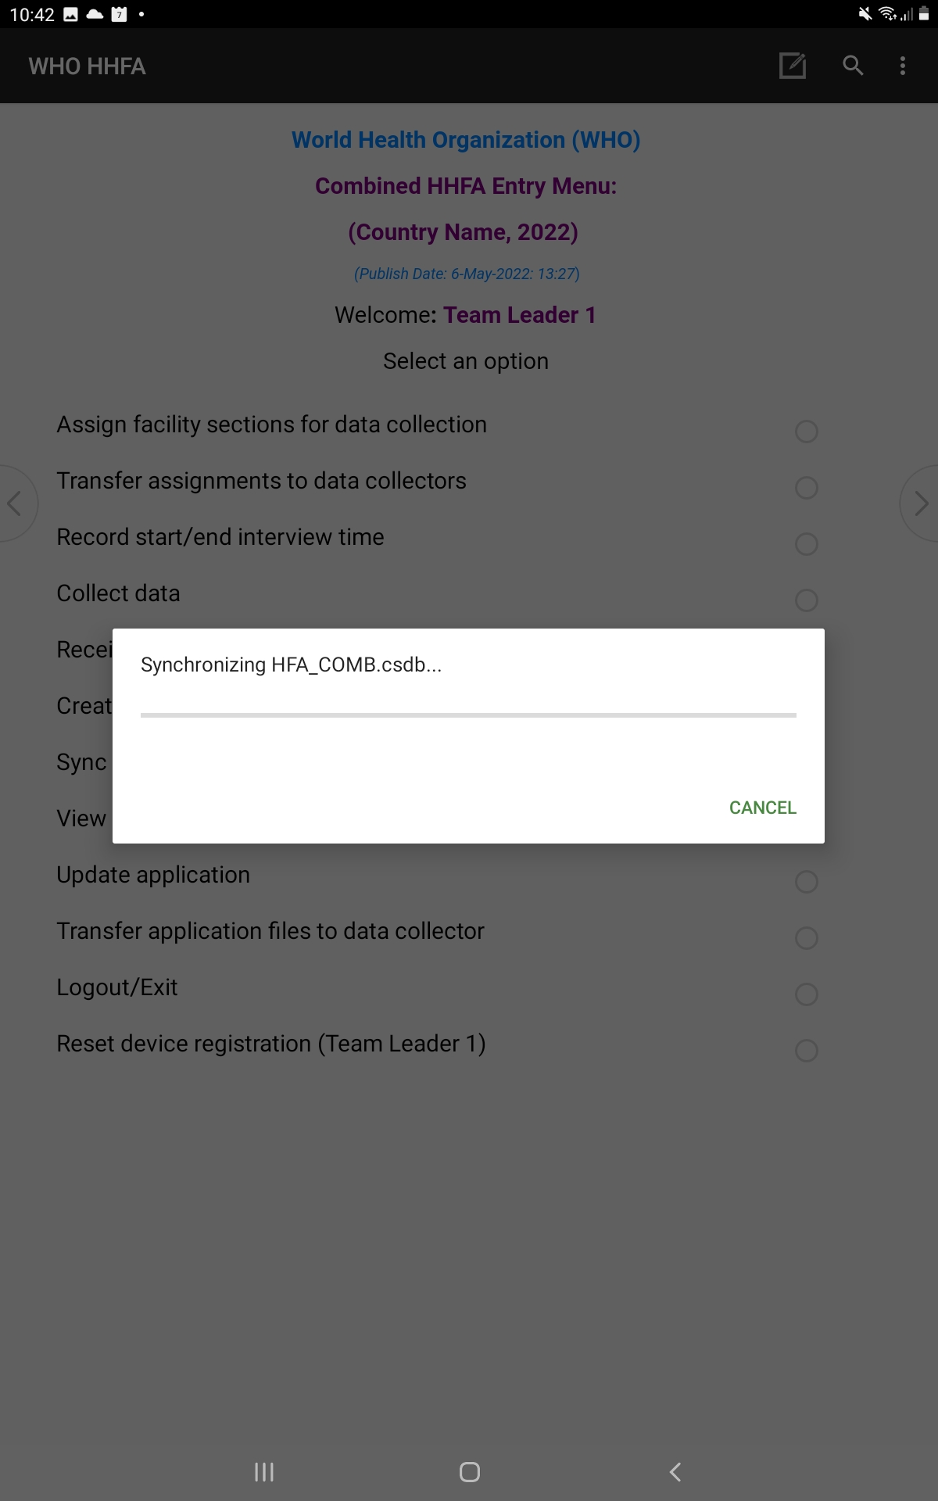
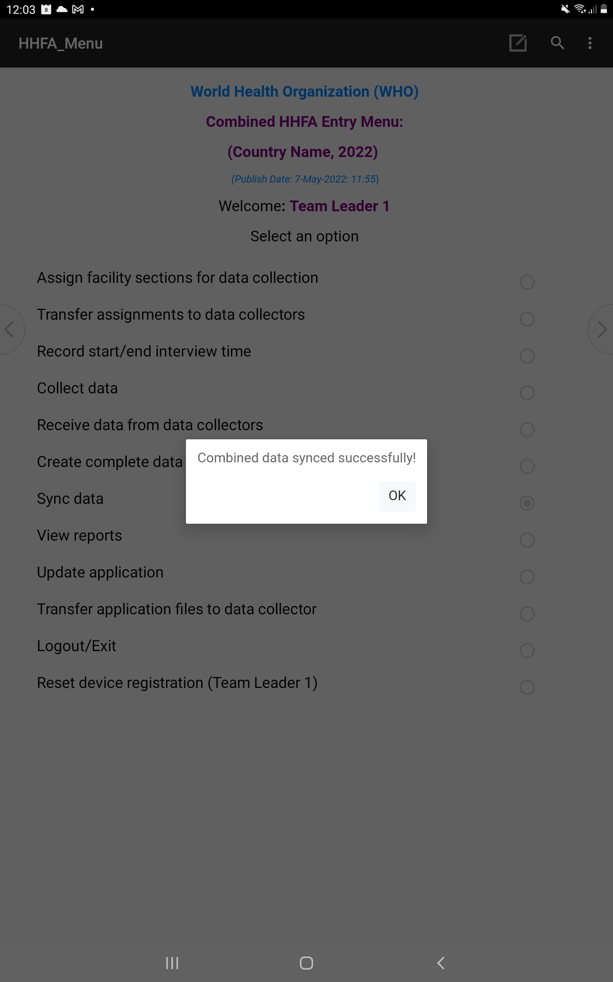
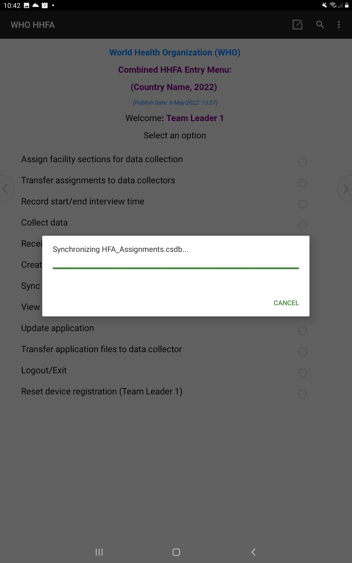
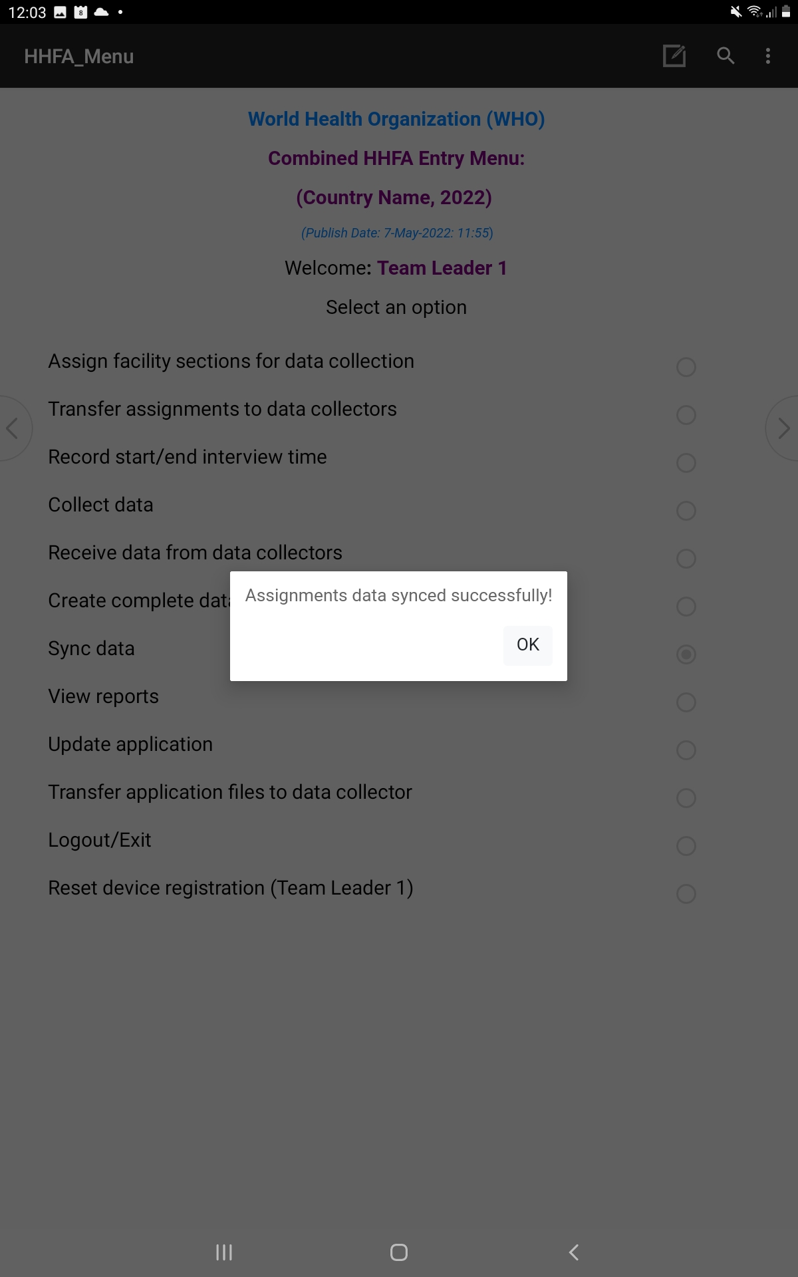
12. Sync data
Team leader
On successful connection, data files are synced
Success messages after data syncing
Notes:
3. on successful connection, the data files are synced;
4. upon successful data sync, three messages will appear to confirm the three data files have been successfully synced.

Slide 22
You have now completed Unit 5.
In the next unit, we will look at the supervisor validations.
First, try the practice exercise.
Notes:
You have now completed Unit 5.
In the next unit, we will look at the supervisor validations.
First, try the practice exercise.

